Slide 1
Topic: Using timetables EQ: How do I plan a day using a timetable?
Year 11 Mathematics Essentials

Slide 2
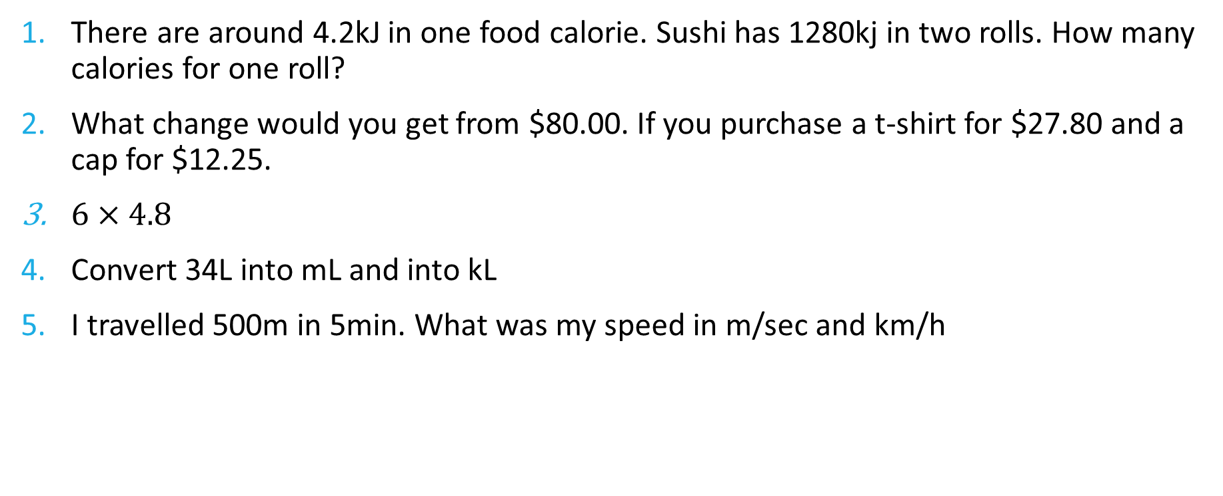
Five Questions
Topic: Using Timetables
Date: XX/XX/2021
EQ – How do I plan a day using a timetable?
There are around 4.2kJ in one food calorie. Sushi has 1280kj in two rolls. How many calories for one roll?
What change would you get from $80.00. If you purchase a t-shirt for $27.80 and a cap for $12.25.
$6×4.8$
Convert 34L into mL and into kL
I travelled 500m in 5min. What was my speed in m/sec and km/h
Notes:
304.8
$39.95
28.8
34000, 0.034kL
1.67m/sec, 6km/hr

Slide 3
24
7
30
Date: XX/XX/2021
Topic: Using timetables
EQ – How do I plan a day using timetable?
Timetables helps us plan journeys to get to a certain location. You can plan a day by using a range of different timetables such as bus, ferry and train timetables.
WICOR

Slide 4
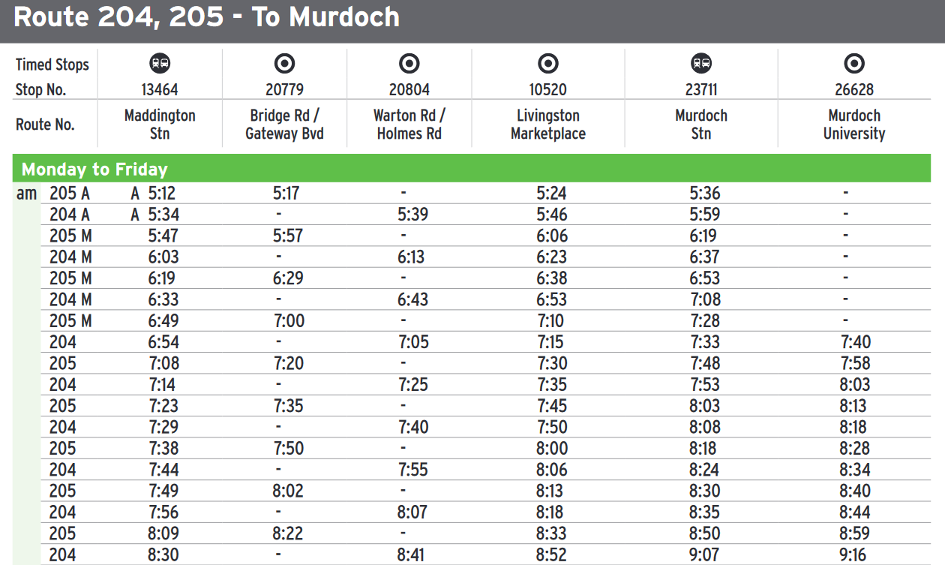
Sarah is a university student that has a exam starting at 8:30am at Murdoch University. It takes her 10 minutes to walk to Maddington Stn.
What time should she leave her house?
What is the most appropriate bus time for her to take? Justify your answer.

Slide 5
Sarah is a university student that has a exam starting at 8:30am at Murdoch University. It takes her 10 minutes to walk to Maddington Stn.
What time should she leave her house? 7:13am
What is the most appropriate bus time for her to take? Justify your answer. The 205 leaving at 7:23
We need to also take into account traffic and the time it takes her to walk to the exam room from the Murdoch University stop.

Slide 6
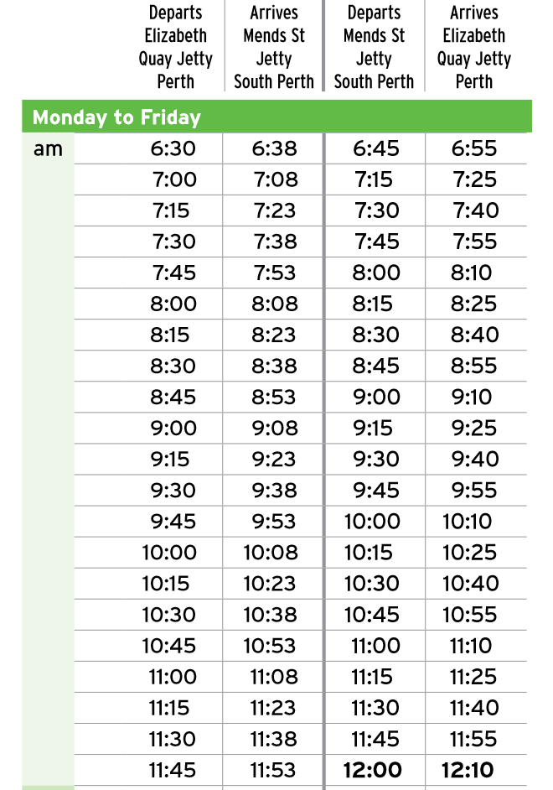
Mike lives at the city and is planning to meet friends at Perth Zoo at 11am. His apartment is a 15 min walk from the Elizabeth Quay Jetty.
What time will he need to leave his apartment and which ferry should he take? He will need to keep in mind the Zoo is a 7 minute walk from Mends St Jetty
How long will the trip take?

Slide 7
Mike lives at the city and is planning to meet friends at Perth Zoo at 11am. His apartment is a 15 min walk from the Elizabeth Quay Jetty.
What time will he need to leave his apartment and which ferry should he take? He will need to keep in mind the Zoo is a 7 minute walk from Mends St Jetty.
He will need to leave at 10:30am and take the ferry leaving at 10:45am
How long will the trip take?
15min + 8mins + 7mins = 30mins

Slide 8
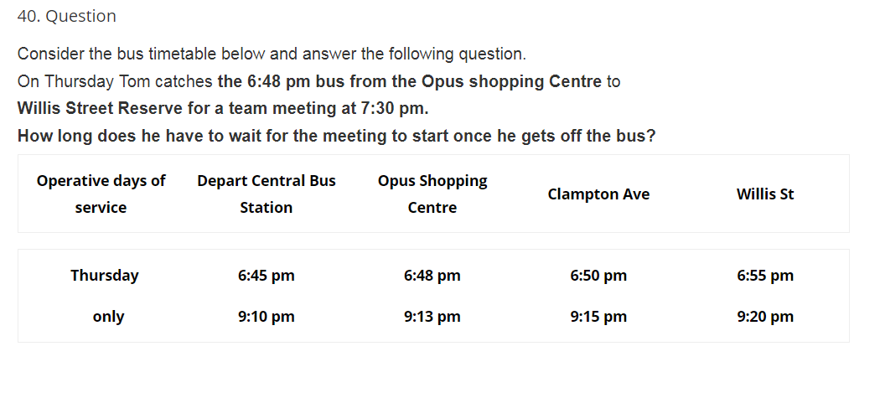
LHS:

Slide 9
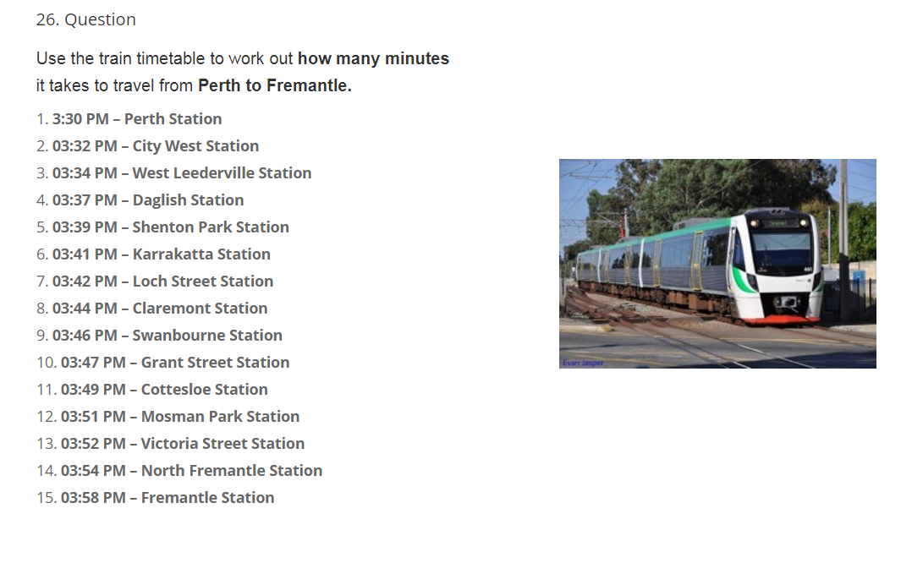
LHS:

